Slide 1

Procedure Writing – MET/CAL© Version 11.0
Notes:
Welcome class to METCAL version 8 Procedure Writing

Slide 2
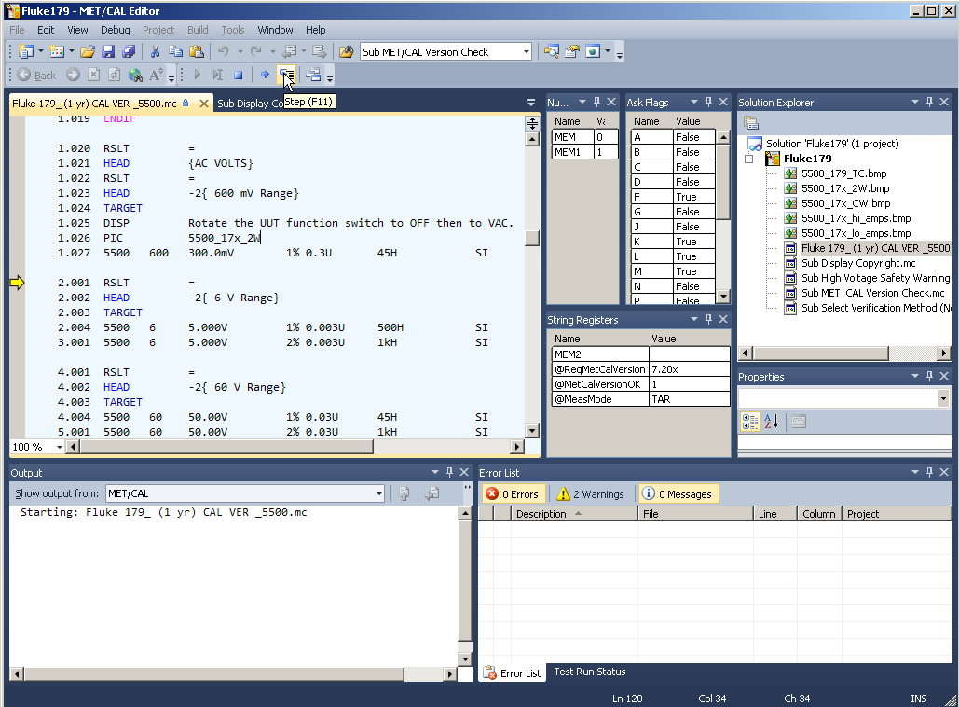
MET/CAL© 8 Main Editor Screen

Slide 3


The New MET/CAL© Paradigm!
Solution -
Project -
pros, pics, exes, etc

Slide 4
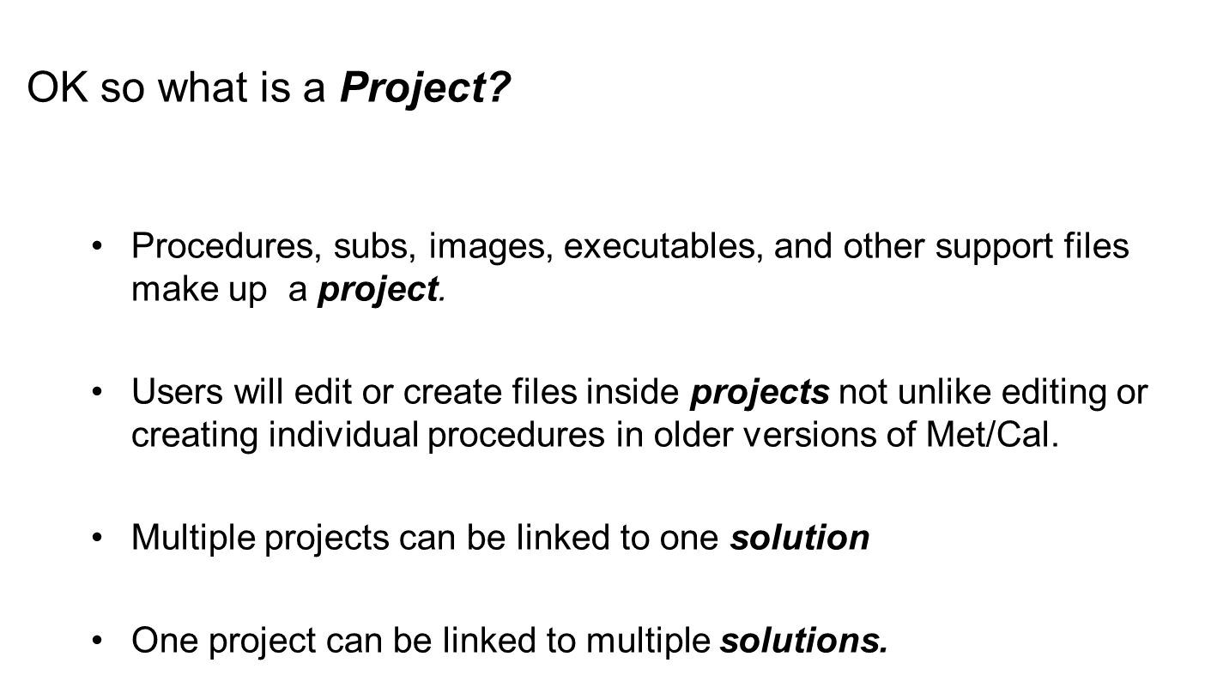
MET/CAL® Editor Changes

Slide 5
MET/CAL® Editor Changes
More about Projects:
  An important element in a project is its Property Page.
    A project definition is not complete without it.
  The Property Page is where you tell Met/Cal what file type you want to publish (save as PXE or PKM).
  It is also where you specify a file name, package date, copyright, author, version, choose whether or not it has been validated and by whom and add comments.

Slide 6

MET/CAL® Editor Changes
Definition: Publish
  Publish in the MET/CAL Editor environment, means to save a file in such a way that it can be run from MET/CAL Runtime.
  You can publish a single procedure.
  You can publish multiple procedures

Slide 7
MET/CAL® Editor Changes
File Types and more on Publishing
  The editor can publish projects to PXE files
    A PXE is a Procedure Executable
      A PXE file cannot be changed unless you have the source Project file.
  The editor can publish individual procedures.
    Any individual procedure will carry the extension type of .mc while being viewed in MET/CAL Editor.
    Regardless of whether it is part of a Project/Solution or not.

Slide 8
MET/CAL® Editor Changes
File Types and more on Publishing
  Individual procedures can still be published to the existing procedure directory.
    procedures that are not part of projects/solutions* can still be edited and published as procedures).
  Existing procedures can be published and imported into projects
  Any pre-existing procedure that was in your directory prior to an upgrade to version 8 will fall into this category.

Slide 9
MET/CAL® Editor Changes
File Extensions Glossary
  .mc
    Text Source code for a procedure
      If you are editing a procedure file in MET/CAL Editor – you are editing it in a text formatted file that carries an extension of “mc”.
      This “.mc” file is THE source code for the procedure.
  .mcproj
    MET/CAL Project
  .mcsln -
    MET/CAL Solution

Slide 10
MET/CAL® Editor Changes
How do I start – to create a project?
  From MET/CAL Editor, Click “File” and “New” “Project from an existing Procedure”
  Lets use the procedure we just edited.
  Select a procedure you want to work on by clicking “find”.
  Highlight “MET/CAL Project” under “Installed Templates”
  Type a name in the “Name” field at the bottom of the screen.
  Note that the Solution Explorer now has the project you names and the procedure file selected right below – again with the extension .mc

Slide 11
MET/CAL® Editor Changes
Creating a Project/Solution
  Repeat the editing steps.
  Publish the procedure.
  If you choose you can publish the Project now
    Either in addition to the procedure – or instead of
  If you have more than one procedure file in a project, publishing the project will publish all of the files in a batch at one time.
  Or if you have multiple files in multiple Projects in a single Solution – you can just publish the Solution.

Slide 12
MET/CAL® Editor Changes
Starting completely from scratch?
  Select “File” “New”, “Procedure File”.
  Type in a name.
  Write your procedure, compiling and publishing as you go, or as you need.
  Then follow the steps in earlier slides to publish it as part of a Project and ultimately a Solution and we are back where we started.
  There are a couple of ways to accomplish this task.
    This is the way that will feel most like the older MET/CAL Editor method.

Slide 13
MET/CAL© Editor

Slide 14
MET/CAL© Editor
MET/CAL Procedure Editor
The MET/CAL Editor is a development tool for creating, editing and maintaining MET/CAL procedures.
Version 8.0 of the MET/CAL Editor is all new and incorporates many features requested in earlier versions of MET/CAL.
The editor is built around the Microsoft Visual Studio Isolated Shell which is at the center of all development using Microsoft tools (C#, C++, VB.NET, etc).

Slide 15
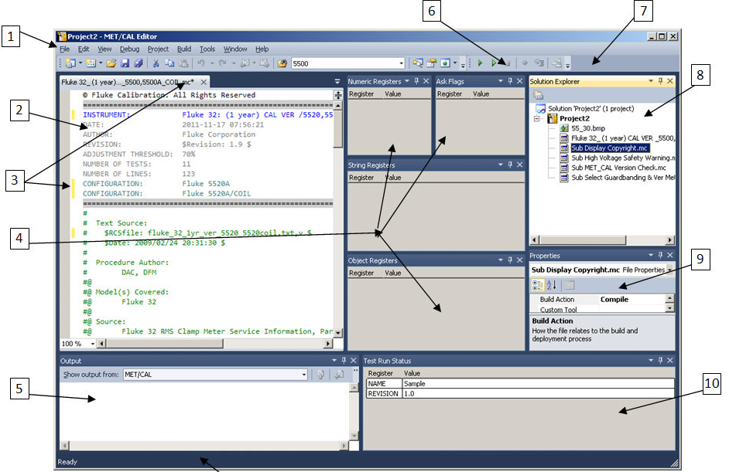
MET/CAL© Editor
11
Notes:
Main Display
Main menu bar: All functions supported by the editor are available in one of the menu items
File Editor Window: An edit window is available for all active documents in the editor.
Change Indicator: When a change is made to an open file, a yellow highlight displays next to the text and an asterisk appears next to the file name. When the file is Saved, the asterisk is removed and the changed text rows are highlighted in green. The highlights are removed after the file or project is closed.
Variable Windows: Program variables and Ask Flags are displayed on individual windows. These windows are not displayed by default and are accessed by using the Debug,Windows menu. Variables cannot be modified using these windows.
Output Window: Displays errors, warnings, and status messages when building and debugging procedures. Separate error and warning windows are also displayed when an error occurs.
Debug Toolbar: Use this toolbar to enable and disable procedure debugging.
Main Toolbar: Right click the toolbar to enable and disable other toolbars or to access the customization dialog.
Solution Explorer: Focal point of the procedure editor. All files and projects opened in the editor are available in the Solution Explorer. Double click any item in the list to open the file. The active item selected controls the options available in the File and Project menus.
File Properties: The properties related to the active file in the Solution Explorer displays in the properties window. The list of available properties differs for files in a project as compared to files opened outside of a project. In all cases the full path and file name is listed in the properties window.
Test Run Status: The active procedure, HEAD, HEAD2, and stimulus information displays in this dialog. This screen is equivalent to the Test Run dialog in 7.X versions of MET/CAL.
Status Bar: Relevant status information related to the current program operation displays in the status bar. Always refer to the status bar when a long operation is active.

Slide 16
MET/CAL© Editor
Customizing the Editor Display
The editor has a very flexible environment that provides features to customize it’s look and feel.
Each window within the editor can be docked to other windows side by side, top and bottom or as a tab.
Individual windows can also be configured to float outside the window of the editor itself.
The screen layout of the editor persists between uses of the program.
After the display is customized, it will remain the same for all subsequent runs of the editor.
Notes:
Depending on the development activity, having different layouts comes in very handy.
Once the screen layout is customized, its settings can be easily saved (Exported), allowing you to switch back and forth between your favorite screen layouts.
This is performed through the Tools > Import and Export Settings menu, which also allows you to reset to original settings.
There are several ways to alter the window layout.
Access windows by using the menu bar.
For example the Debug, Windows menu. When a window is open Right-Click the menu title bar to display docking options.
Double click the top of any docked window to automatically un-dock it.

Slide 17
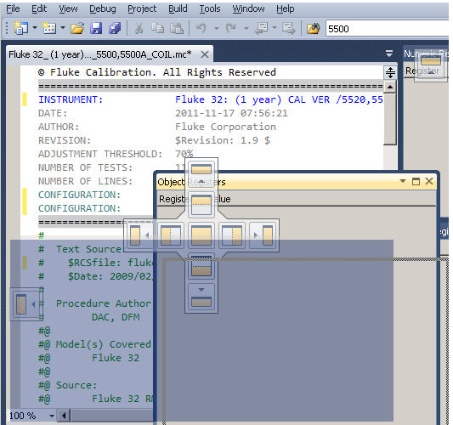
MET/CAL© Editor
Docking Windows
Notes:
Click and drag the top of any window to display the docking options.
The docking options are a group of individual icons that represent where a window will be docked.
While dragging the window place the cursor over the desired docking option and release the mouse button.
The window will dock depending on the selected docking option.
The docking location shades on the display as the cursor is placed over the various docking options.
The docking options change based on the window under the window that is being dragged.
DEMO the docking properties Live.

Slide 18
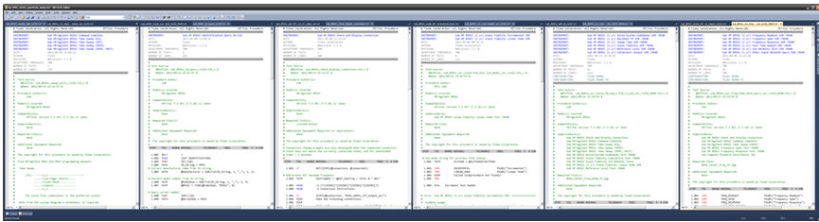
MET/CAL© Editor
Different Window Configurations
The Editor is configurable for many different display configurations
Two Monitors – Multiple Procedures
Notes:
This screenshot shows the IDE window stretched across two high-resolution, widescreen monitors.
Six docked, vertical tab groups are configured side-by-side; with three in the left monitor and three in the right.
The spacing between tab groups was adjusted so that the left group of three meets the right group of three exactly where the two monitors physically come together, creating an invisible transition.
Each tab group actually has two procedure files open per group, for a total of 12 files open and visible at the same time.

Slide 19
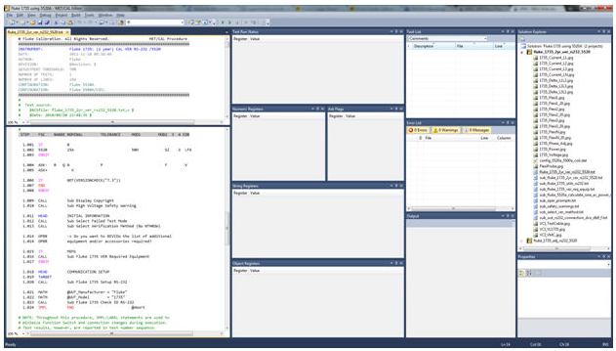
MET/CAL© Editor
Single Monitor – Split Procedure plus Other Views
Notes:
This screenshot was configured using one high-resolution, widescreen monitor, using a combination of docked, vertical and horizontal tab groups.
The procedure window at the far left is in a vertical tab group; the procedure window is also split, showing two sections of the same procedure simultaneously.
The remaining groups are all horizontal tab groups, one includes several views related to Debug Mode, the next group includes Task List, Error List, and Output. The final group includes the Solution Explorer and Properties window.

Slide 20
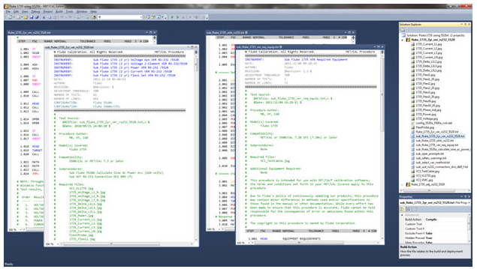
MET/CAL© Editor
Single Monitor – Floating Windows
Notes:
This screenshot shows how windows can be designed to float, instead of docked.
Four procedure windows are floated, while the Solution Explorer and Properties windows remain docked in a horizontal tab group.
Nearly all windows can be floated or docked, not just the procedures; you can even make floating tab groups!

Slide 21
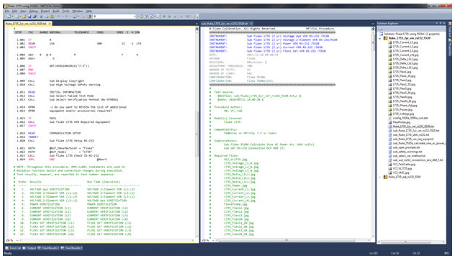
MET/CAL© Editor
Single Monitor – Minimized Tool Views
Notes:
This screenshot shows a basic layout with vertical tab groups.
The difference here is that several of the Tool Views have been minimized using Auto Hide.
Four views have been minimized to the bottom of the screen, and two to the right.
These can be viewed by mousing over them, clicking them, or in some cases they will be presented automatically as a result of Editor operations (like procedure compile errors).

Slide 22
MET/CAL© Editor
What is a MET/CAL Procedure?
MET/CAL operation is centered around procedures.
They are used by the MET/CAL Runtime program to perform a calibration.
Created, edited and maintained by the MET/CAL Editor
A MET/CAL procedure is a file containing MET/CAL commands called Function Select Codes or FSC's.
Procedures are written for specific instruments and follow the manufactures' written calibration procedure
Notes:
Procedures are the heart and soul of MET/CAL and are used by the MET/CAL Runtime program to perform a calibration.
They are created, edited and maintained by the MET/CAL Editor.
A MET/CAL procedure is a file containing MET/CAL commands called Function Select Codes or FSC's.
FSC's are the key words in the MET/CAL procedure language.
The MET/CAL Reference Guide (located in C:\ProgramData\Fluke\Help) contains a complete list of all of the FSCs.
Pressing CTRL+Space in the editor also displays a list of all available FSCs.
Press F1 to access help specific to any FSC.
Procedures are written for specific instruments and follow the manufactures' written calibration procedure.
Procedures sometimes call other procedures which are called sub-procedures.
Procedures are flexible and can display graphic images and may use external text and data files.
The Procedures are used by the MET/CAL Runtime program. The Runtime program executes the procedure, determines if the calibration has passed or failed. Calibration information is saved in the MET/CAL database for later use. Reports containing the calibration data can be viewed or printed.

Slide 23
MET/CAL© Editor
Projects and Solutions
Version 8.0 introduces a new capability called Projects.
All of the components that make up a Project are saved to a single file called a Procedure Executable.
The file is easily distributed to other workstations or other labs.
The file cannot be altered and the contents cannot be viewed.
The project keeps all of the project's building blocks together within the project.
Without a project, it is up to the procedure author to ensure that all dependent files are located in the folders specified by the metcal.ini file.
Notes:
Projects bundle together all of the procedures, sub-procedures, images, external files, and other files used in a calibration procedure into a single file, called a Procedure Executable that can be run by the MET/CAL Runtime program.
The project keeps all of the project's building blocks together within the project. This is a departure from previous versions of MET/CAL which did not manage the files that a procedure depended on to run successfully. Without a project, it is up to the procedure author to ensure that all dependent files are located in the folders specified by the metcal.ini file.

Slide 24
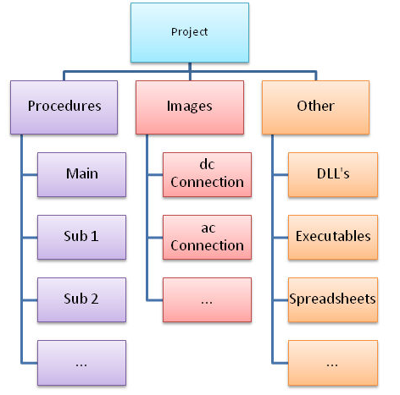
MET/CAL© Editor
What is a MET/CAL project?
Notes:
MET/CAL Projects are containers that procedure writers use to organize their procedures, sub-procedures, bit-map images and other dependent files.
The project contains all of the building blocks need for a procedure to successfully run.
Projects can be created manually, adding sub's and other building blocks one item at a time, or have the MET/CAL Editor build a project from an existing procedures or packages (PKM file).
Each project is limited to one main procedure. The main procedure file represents the entry point of all procedures in a project. When a Procedure Executable created from the project is selected in the Run Time, only Instrument lines in the main procedure are listed for selection. The other procedures in a project are accessed using CALL statements.
To make a procedure a main, reference the properties of a procedure file to specify a procedure file as the main procedure.

Slide 25

MET/CAL© Editor
The MET/CAL project
Managing sub-procedures
In previous versions of MET/CAL, sub-procedures were often shared among several procedures. This sometimes created problems.
Notes:
It is common when procedures are written for families of instruments or classes of instruments.
While efficient, the lack of procedure management tools could allow a procedure writer to enhance a sub-procedure for one instrument and not being aware that the sub-procedure is shared by other procedures negatively affect the operation of a different procedure.
In this example, sub-procedure 2 is used by two different procedures. Altering it to enhance procedure 1 could cause a problem in procedure 2 that may not be known until procedure 2 is actually used. If there is no record kept about the changes, debugging the problem may be difficult. The use of a procedure project and compiling procedure executables will avoid this issue.

Slide 26
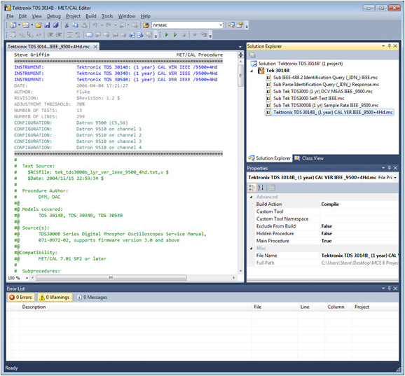
MET/CAL© Editor
Notes:
When a project is opened in the MET/CAL Editor, all of the procedures, sub-procedures, images and other required files are brought into the editor.
In this example, the Tektronix TDS 3014B project has been opened.
The Solution Explorer shows that the main procedure and its 5 sub-procedures are available.
A procedure or sub-procedure can be opened for editing by clicking its name in the Solution Explorer.
When the project is saved, all of the project files are saved as a group.

Slide 27
MET/CAL© Editor
Solutions
A solution is used to maintain all files within the Procedure Editor.
All files accessed in the editor are accessed through solutions.
The solution may have 0 or more projects.
Files opened without a project are listed in a solution as "Miscellaneous Files".
All files opened using the File, Open, Procedure menu are opened without projects.
Note the "(0 projects)" text that displays next to the solution name.
In 0 Projects mode, options to create a procedure executable or manage project properties are not enabled.
Notes:
This functionality closely resembles the behavior of 7.X versions of the MET/CAL Editor.
Files are individually edited and accessed. Procedures and other files used by a procedure must be published to the proper location.
For example, two procedures A and B are in the solution and procedure A calls procedure B. Debugging of procedure A requires that procedure B be published to the active compiled procedure directory. When debugging a new window with the published source of procedure B will display while procedure A executes. In this case 2 windows for procedure B will display. When the debug session ends, compiled procedure window for procedure B will close.

Slide 28

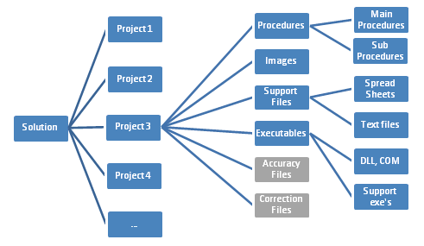
MET/CAL© Editor
Notes:
A solution that contains 1 or more projects is a more typical use of a solution.
There is no relationship requirements amongst the projects within a solution.
An example grouping is that one project is used for an adjustment procedure of an instrument and another project is used for the validation procedure of the same instrument.
In this scenario the two projects may share many of the same files so that editing the two projects at the same time is convenient. Although the two projects may share many of the same files, each project must still have it's own reference to its required files. A project can belong to more than one solution.

Slide 29
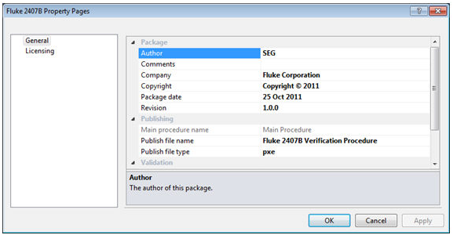
MET/CAL© Editor
Project Properties
All Projects have properties
The menu is named based on the active project selected
Project properties are provided to associate information with all files in the project
Notes:
All Projects have properties.
When a project or a file in a project is selected in the Solution Explorer, the Project menu will contain a Properties item.
The menu is named based on the active project selected in the solution explorer. The project properties are provided to associate information with all files in the project. Some of the information provided on the Properties dialog is presented in the MET/CAL Run Time when Calibrate, Run Procedure Executable menu choice is selected. Take this into consideration when changing the properties for a project.

Slide 30
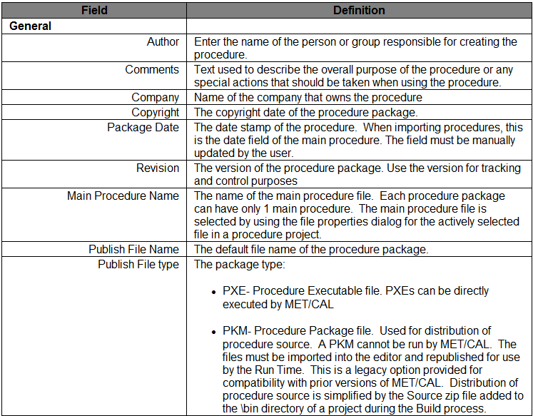
MET/CAL© Editor
Properties Fields Explained

Slide 31
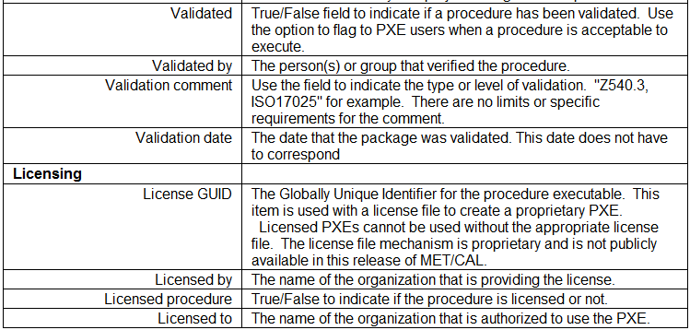


MET/CAL© Editor
Properties Fields Explained, continued

Slide 32
MET/CAL© Editor
Building and Publishing
Procedures Without Projects
Procedures developed outside of projects do not support the build operation.
These procedures are edited, debugged then published.
Any procedure opened with the File, Open Procedure option is opened outside of a project.
However, files in a procedure project can also be published as individual compiled procedure files.
Only procedures that compile can be published.
Notes:
MET/CAL 8.0 also introduces the concept of Building and Publishing procedures.
These operations are now an integral part of procedure development and execution

Slide 33

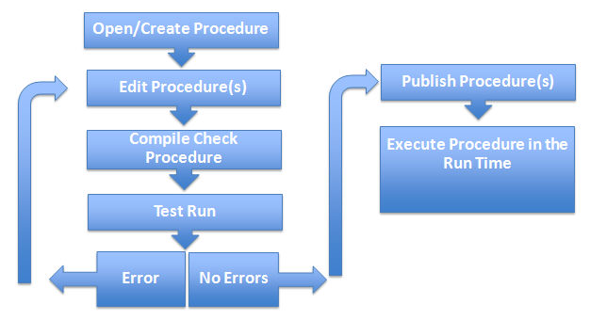
MET/CAL© Editor
General flow chart of editing and publishing a procedure that is not in a project.
Notes:
Publishing the procedure adds it to the current or user selected compiled procedure directory.
A publish operation is required to allow the Run Time to execute the procedure.
Select one or more procedures in the Solution Explorer prior to using the Build, Publish Procedure(s) option to publish more than one procedure at a time

Slide 34
MET/CAL© Editor
Open an existing procedure using the File, Open Procedure menu choice, or create a new procedure with CTRL+N or File, New Procedure.
Add text to the instrument line, and edit the procedure content.
Press F9 to Compile Check the procedure. This process ensures that all procedure content is valid and that the procedure can be compiled.
Test Run the procedure by using F5. Use the Debug Toolbar or short-cuts to control the debug process.
Repeat steps 2-4 until the procedure meets expectations.
Publish the procedure using the Build, Publish Procedure(s) or Build, Publish Procedure(s) To option to add the procedure to the compiled procedure directory.
Use the Procedure Selector to hide procedures that should not be accessible by the Run Time.
Use the MET/CAL Run Time, Calibrate menu to launch the published procedure.
Notes:
Steps to create a procedure without a project

Slide 35
MET/CAL© Editor
Building Procedure Projects
The Build and Publish process does the following:
Verifies that all procedures in the project compile without errors. Warnings do not prevent a compiling. Reference the Output window to view build process errors. The Status bar also updates with general progress information.
Scans each procedure and verifies procedures referenced in CALL statements are in the project. Even files market as Exclude from Build in the file properties must be in the project however they will not be added to the final PXE.
Scans each procedure and verifies that each image referenced by a PIC statement is in the project. If a variable is used to reference the image, the file cannot be verified. In this case, it is up to the user to ensure that the picture is included in the project or is in the active pic directory defined by the metcal.ini file.
Notes:
Procedure projects require a build operation prior to debugging or publishing the project.
The build operation is automatically triggered when Start Debugging is selected, the Build, Publish Package option is used or when any of the direct build options are selected in the Build menu.

Slide 36
MET/CAL© Editor
Building Procedure Projects, continued
Scans each procedure for DOS statements and ensures that the application called by the statement is in the project. Similar to pictures, if a variable is used the program cannot be verified at build time. It is up to the user to ensure that the file is included in the project or is in the User_Prog_Dir or the User_CWD defined by the metcal.ini file.
All files in the project that are compressed and added to a zip file that is named the same as the Package File Name defined in the Project Properties dialog. The file is copied to the \Bin directory relative to the active procedure project file.
The zip file contains all relevant source files necessary to rebuild the Procedure Project. Use this file to transfer source to another user if it is necessary to rebuild the project on a system that does not have access to the original project files.
Regardless of the Package Type selection in the Project Properties, a PXE file is also created in the \Bin project sub directory. All debugging is performed by using the PXE file in this folder.

Slide 37
MET/CAL© Editor
Building Procedure Projects, continued
If the Build operation was initiated by Start Debugging, the actively selected procedure will execute starting at the first line of code. Debug from Cursor will always begin at the current cursor point of the active procedure.
When the Package Type selection in the Project Properties dialog is PKM and building was initiated by a Publish operation, a PKM file is also created in the \Bin directory.
When the Build, Publish Package option is used, the PKM or PXE file is copied to the target location selected by the user when the option was first pressed. Note publishing a package is effectively a file copy operation to move the package from the \Bin directory to the Run Time working directory. The default folder is the current compiled procedure directory.
For archival purposes, it is good practice to backup the project Zip file with the PXE after publishing. This is a user specific operation that is not handled by the procedure editor.
Notes:
Note
Prior to publishing a PXE, ensure that all Project Properties are up to date. Regardless of changes to the procedure project, the PXE will remain unchanged over time. The properties in the PXE can be used to help to determine the state of the PXE when published and distinguish PXEs published from the same project at different times.

Slide 38
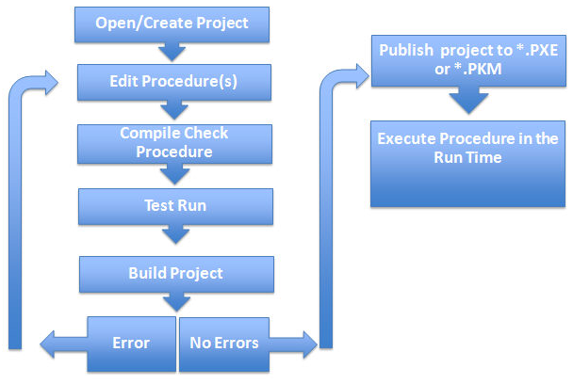
MET/CAL© Editor
A flow chart of the Build/Publish sequence for procedures in a project

Slide 39
MET/CAL© Editor
Migrating Procedures from 7.X to 8.0
The compiled procedure format has not changed.
MET/CAL has always used a compiled procedure format consisting of a proc.dir file and numbered .pro files for each procedure.
The MET/CAL Editor has always allowed procedures to be created, opened, edited, and saved to this compiled format.
The format of the *.pro files has not changed with MET/CAL 8.0.
Procedures created with MET/CAL 8.0 can function on earlier versions of MET/CAL, as long as new functions are not employed which require version 8 (5522A FSC, LIB FSC, etc.).

Slide 40
MET/CAL© Editor
Procedure Source Code as Text
Earlier versions of MET/CAL had the ability to maintain procedure source code as text files.
Many customers elected to save everything in the compiled procedure format since this was the default MET/CAL behavior.
Pressing standard keyboard shortcuts like Ctrl+S saved procedures to the default proc.dir in compiled format, not to text files on a hard drive.
Saving the same procedure as a text file required extra steps.
Using the compiled procedure format has a few drawbacks

Slide 41
MET/CAL© Editor
Drawbacks
Procedure edits are saved to the “live” procedure directory from which they were opened.
Additional, manual steps were necessary to copy procedures to a temporary proc.dir before beginning development.
Once development was finished, additional, manual steps were required to get the procedure copied back into the “live” directory.
It is more cumbersome to return to a specific state of procedure execution when multiple individual procedure files can be edited over time.
Source code could only be edited within the Editor, one procedure at a time.
Powerful text manipulation tools could not be used to edit procedure source code.
Find/Replace operations were limited to one procedure at a time.
Revision control was nearly impossible to implement.
Notes:
1. Others users that share the procedure directory are immediately impacted by changes made. For better or for worse.
4. For example, it is may be difficult to determine the exact procedures used to calibrate an instrument 2 years ago.

Slide 42
MET/CAL© Editor
MET/CAL Editor 8 Changes
All procedures are saved as text files in UTF-8 format with a *.mc file extension.
Default save operations (Ctrl+S) now save procedures as text files with a .mc file extension.
Existing procedures that are opened or “imported” to the new Editor are saved as .mc files.
Files can be organized logically in directory paths, instead of having everything in a flat structure. This is not a requirement. Users are welcome to save in a flat structure or a complex directory hierarchy.
Procedures must be Published using the Build, Publish Procedure(s) option to be available for use by the MET/CAL Run Time.

Slide 43
MET/CAL© Editor
MET/CAL Editor 8 Changes
A new PXE file can be used to run a procedure. The file cannot be changed after it is created.
It is much easier and faster to work with multiple procedures at once. The ability to search and modify multiple procedures at the same time is available with and without projects.
The new Editor includes powerful text manipulation tools.
Quick Find/Replace operations now work in the Current Window, All Open Documents, the current Project, or the entire Solution.
New Find/Replace In Files adds more powerful operations to match those in Quick Find/Replace, plus adds capability to work on closed files, and files located on a disk drive outside of the current Solution.
External text manipulation tools can also be used on .mc files, if desired.
Notes:
Eliminates reliance on external tools and applications.
Find/Replace operations have been greatly expanded:
Wildcards and regular expression matching are now supported.

Slide 44
MET/CAL© Editor
Editing Procedures Without Projects
Open existing procedures using the File, Open Procedure menu choice or create a new procedure using the File, New Procedure menu choice.
The previous keyboard shortcut CTRL+N is still available to create a new blank procedure.
Procedures created in this way are maintained outside of projects.
After a compiled procedure is opened, use the *.mc version of the procedure for all edits and to verify functionality in a test run.
Publish the procedure to add it to the compiled procedure directory*.
Notes:
*Review Selecting a Procedure for additional details.

Slide 45
MET/CAL© Editor
Importing Procedures to Projects
There are 3 ways to create projects from existing procedures.
File, New Project from Existing Procedure: Select a single main procedure. The editor will import all procedures referenced by CALL statements, pictures referenced by PIC and PICE statements and programs used by DOS and DOSE into a project.
File, New Project from Existing *.pkm File: Select a PKM file and a single main procedure from the PKM file. The editor will import all procedures referenced by CALL statements, pictures referenced by PIC and PICE statements and programs used by DOS and DOSE into a project.
File, New Project: Create a new empty project. Right click the project node in the solution explorer and choose the Add option to add new or existing files to the project. Alternatively use the Project menu to add files to the project. The project menu supports adding files only when the project node is selected in the solution explorer.
Notes:
In all cases the import process does not alter the original files.
After a project is created always use the Project, Properties menu to customize the project properties.
PXE files are the typical output of a procedure project.
The project properties are visible to users in the MET/CAL Run Time when the PXE is selected.
Notes for 2 and 3
Images and programs referenced as variables are not imported automatically. By default procedures are converted to *.mc files and copied to the procedure project directory. Files that could not be located display with a caution symbol in the solution explorer.
. Images and programs referenced as variables are not imported automatically. By default procedures are converted to *.mc files and copied to the procedure project directory. Images and programs can be copied to the current metcal.ini file defined path or copied to the current project directory. A prompt is provided during the import process to determine where the files will be imported. Files that could not be located display with a caution symbol in the solution explorer.

Slide 46
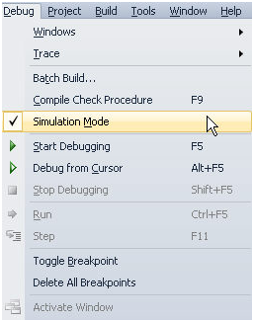
MET/CAL© Editor
Test Run Procedures
The ability to test run a procedure is now maintained in the Debug menu. All features associated with Test Run functionality are described as Debugging in MET/CAL 8.0 (in the Help file!). A toolbar and corresponding menu choices are available to enable and disable debugging.
Notes:
While debugging other windows can be viewed, however editing a procedure is not allowed.

Slide 47
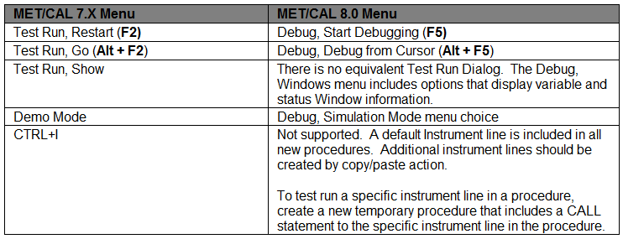
MET/CAL© Editor
Changes to Common Functions

Slide 48
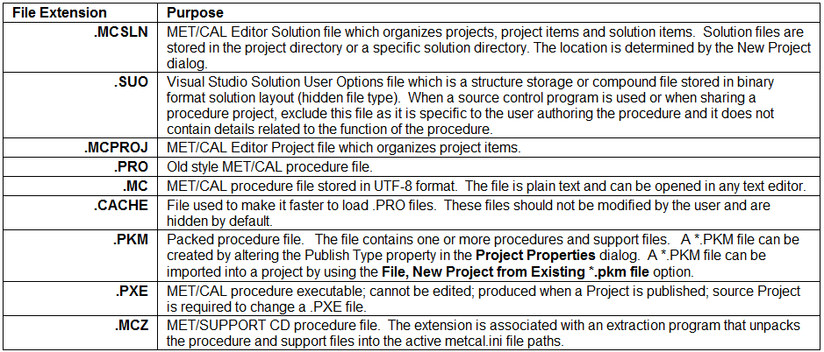
MET/CAL© Editor
File Types supported by MET/CAL Version 8.0

Slide 49
MET/CAL© Editor
UTF-8 ??
MET/CAL 8.0 stores procedures files using UTF-8 format.
UTF-8 is a Unicode format that supports universal transport of characters created on operating systems with different code pages.
See Unicode Character Encoding in the MET/CAL User’s Guide for more information.

Slide 50
MET/CAL© Editor
Synopsis of Editor Menus
The Procedure Editor menu consists of familiar menu options and some that are new and specific to the MET/CAL Procedure Editor. The available top level menus listed on the next slide.

Slide 51
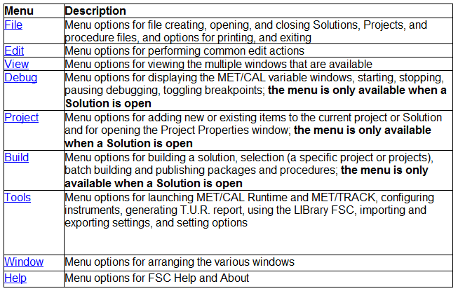
MET/CAL© Editor
Editor Menus and Descriptions

Slide 52
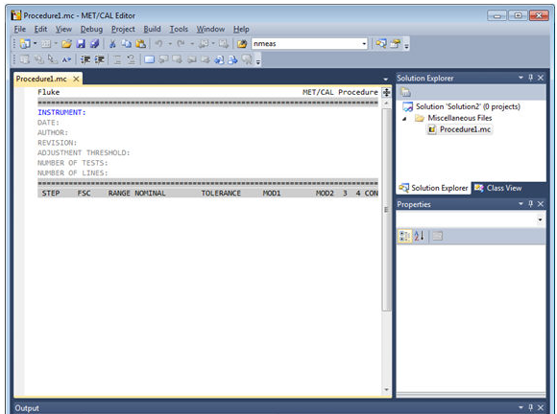
MET/CAL© Editor
Creating a New Procedure
From the main menu, click File, New, New Projectto create a new empty procedure named ProcedureXX.mc (where XX is a number chosen by the editor)
Notes:
This is the procedure source file and will contain the procedure in text form.
Use the File, Save As option to rename the procedure if desired.
Creating a procedure in this fashion is equivalent to creating procedures in versions of MET/CAL prior to 8.0.
The procedure is added to the Miscellaneous Files node and is not part of a project.
When the procedure edits are complete use the Build, Publish Procedure menu option to make the completed procedure available to MET/CAL for use in a test.

Slide 53
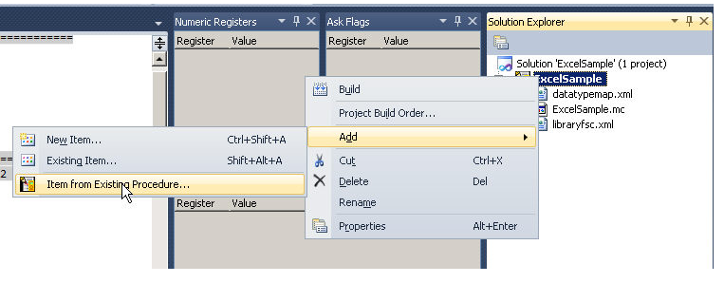
MET/CAL© Editor
To add a procedure to an existing project, right click the project name and choose the appropriate Add option. Use the Item from Existing Procedure selection to add an existing compiled procedure to a project.

Slide 54
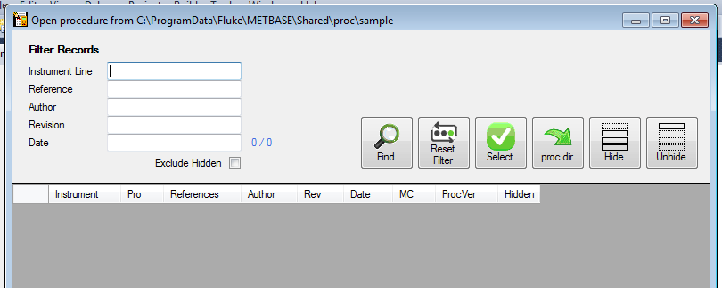
MET/CAL© Editor
Selecting a Procedure
The Procedure Selector is used to select all procedures that are currently in the procedure directory.
Notes:
After a procedure is opened it is converted into a *.mc file.
All edits to the procedure are made to the *.mc file.
The compiled procedure in the procedure directory is updated only when the *.mc file is published using the Build, Publish Procedure(s) menu option.
Procedures that already exist as *.mc files can be selected using the File, Open File menu choice.
The File, Recent Files menu is also a useful shortcut to accessing procedures that have been recently used.
Opening a procedure from the procedure directory when a *.mc version of the procedure already exists will generate a warning giving the user the option to open the existing *.mc version of the file or to open the procedure directory version of the file and overwrite the existing *.mc file. If the *.mc file has previously been published, the date and times of the files will be similar and the contents of the files will be the same.

Slide 55
MET/CAL© Editor
Saving a Procedure
With the new editor, saving a procedure has a new meaning.
Saving a procedure in all prior versions of MET/CAL directly modified the compiled procedure directory.
When editing a *.mc file, the various file save options simply save the file or procedure project but do not modify the compiled procedure directory.
The Build, Publish Procedure(s) and the Build, Publish Procedure(s) To options are the only way to update the compiled procedure directory.
Procedure files that cannot be compiled cannot be published however, they can be saved as text in the *.mc file format.

Slide 56
MET/CAL© Editor
Save Options
The File, Save and File, Save As menu options vary based on the active selection in the Solution explorer.
When an individual file is selected, the save operation is specific to the file. When a project or a solution is selected the save operation is specific to the project or solution.

Slide 57
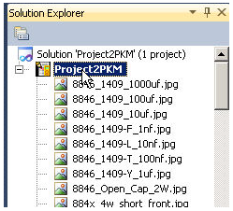

MET/CAL© Editor
Use the Save All option to save all items that have been altered in the current solution.

Slide 58

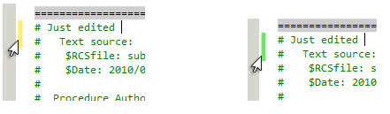
MET/CAL© Editor
Files That Have Changed
Files that have changed include an asterisk after the file name on the file's edit dialog
File changes are indicated by a yellow highlight next to the file text. After the file is saved, the highlight changes to green.

Slide 59
MET/CAL© Editor
Printing a Procedure
The File, Print menu opens a dialog box that lets you print the current procedure. To print the procedure to a PDF, install a PDF printer and select it as the print device in the print dialog.
To print a procedure, proceed as follows:
1. Open the procedure you want to print.
2. From the File menu, select Print.
A Print dialog box appears.
3. Choose the options you want and select OK to print the active procedure
Notes:
A pdf printer driver is not included with the software package

Slide 60
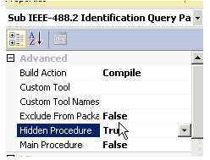
MET/CAL© Editor
Hiding a Procedure
The Procedure Selector has features to hide and unhide procedures in the active Compiled Procedure directory
In a procedure project use the file properties dialog and choose True as the Hide Procedure option.
Notes:
Hiding procedures makes them invisible to the MET/CAL Run Time.
It is common to hide sub procedures or procedures under development.

Slide 61
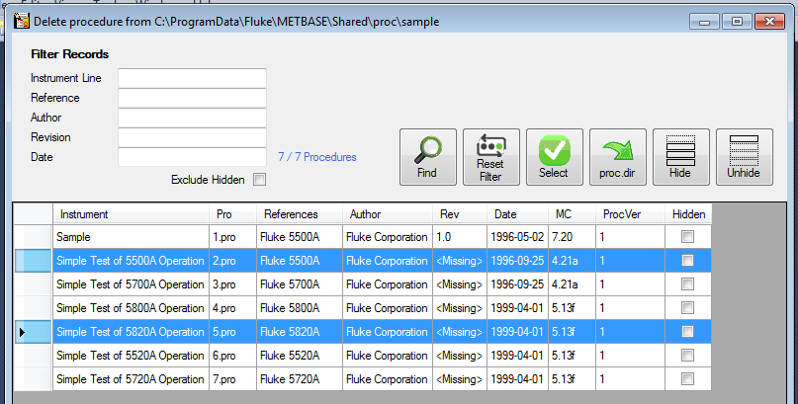
MET/CAL© Editor
Deleting a Procedure(s)
After the files are deleted they cannot be restored
Notes:
The File, Delete Procedures option in the Procedure Editor is provided to remove compiled procedures from the active procedure directory.
Procedures deleted in this way are also removed from the hard disc so ensure that the proper procedure is selected when this option is used.
The Procedure Selector is provided to select procedures to delete.
Select one or more procedures and press select to remove them from the procedure directory. A second confirmation message is presented before the procedures are removed. After the files are deleted they cannot be restored

Slide 62
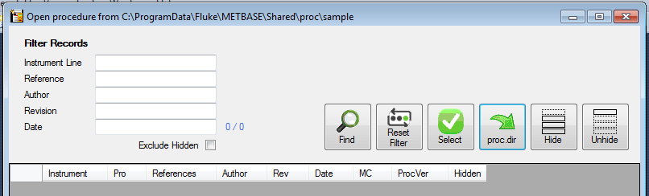
MET/CAL© Editor
Change the Default Directory for Compiled Procedures
The MET/CAL Run Time, the Procedure Selector and the metcal.ini file can all be used to change the default procedure directory. This directory represents the location of compiled procedures and is used as the default directory for procedure executables.
Press to select the Directory
Changing the Default Directory from the Procedure Selector
Notes:
Show a demo of changing the default directory.

Slide 63
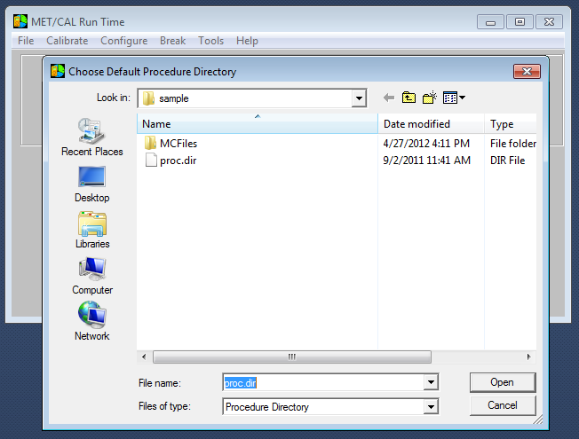
MET/CAL© Editor
Changing the Default Directory from the Runtime
Notes:
In the runtime, File – Change Default Directory… Or CTRL D

Slide 64
MET/CAL© Editor
Default Directory
Why it is useful
  User can create a directory for procedure development.
    Separate development from “released”
  User can divide procedure into categories
    Scope, DMM, temperature…
Notes:
With MetCal 8,

Slide 65
MET/CAL© Editor
Compile Checking a Procedure
The Debug, Compile Check Procedure (F9) checks the contents of the active procedure and reports errors in the Error window and warnings in the Warning window. The compile check does not check dependencies outside of the procedure file itself. Errors must be corrected before you can run the procedure. If no errors are present, the procedure is formatted and fields are lined up under the correct columns.
T.U.R. Checking - Procedure lines that contains an instrument evaluation FSC, the Test Uncertainty Ratio (T.U.R.) is calculated in most cases.
Automatic Line Check is operating as long as the Editor is not operating in Text Mode. The same checking as described above is performed on every procedure line as you enter it. When you press [ENTER], the line check is triggered. If no errors are found, the line is formatted, and the cursor is placed on the next line ready for the next procedure statement.
Notes:
If the T.U.R. is less than the “tur_lim” parameter specified in “metcal.ini,” a warning message is generated and presented in the Warning window. T.U.R. warnings are not considered errors, and so do not prevent a procedure from being executable. The procedure writer must verify that the new procedure is adequate, and that the standards used are satisfactory for the calibration to be performed.

Slide 66
MET/CAL© Editor
Debugging
Debugging a Procedure
Debugging a procedure is the process of executing the procedure to see how it performs.
The procedure must be executable before debugging can begin.
When debugging a procedure project, all procedures in the project must compile and all dependencies must be valid and part of the project.
Notes:
The procedure does not have to be published to a PXE or the complied procedure directory to start debugging. Use the features in the Debug Menu to begin debugging and control the debug process. When you test run, you are not asked for pre- and post-calibration information, and no results are written to the database.
When working with procedures outside of a project, the there is no check for dependencies. As long as the procedure compiles debugging will begin when Start Debugging is selected.
In early stages of procedure development it is common for some procedures in the project to not compile or to have unreconciled dependencies.

Slide 67
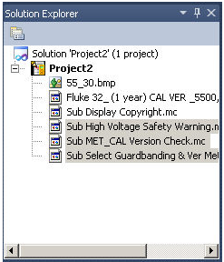
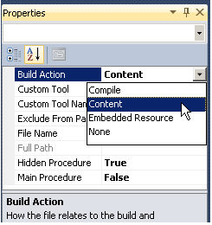
MET/CAL© Editor
To enable debugging without resolving all issues in procedures, select all affected procedures in the Solution Explorer (CTRL+Click to multi-select), press F4 to display the file properties and choose Content as the Build Action property. This selection prevents the build process from attempting to compile the selected procedures. Make sure to change the build action back to Compile before publishing the procedure.

Slide 68
MET/CAL© Editor
Debug from Cursor
Runs procedure from the line where the cursor is currently positioned.
When the procedure is completed or terminated, the values of certain parameters are remembered, so that the next time you execute the procedure, it is not necessary to repeat the test steps that establish those values.
The system remembers the following parameters:
ASK flags, created using the ASK- and ASK+ FSCs.
Memory variables MEM, MEM1, MEM2, and M1 through M255
Values created with Instrument Setup FSCs ( For example, MMFC, MCAL, and 606 FSCs).
MESS message buffers, created with the MESS FSC.
DRAW parameters, created with the DRAW FSC.
SET settings table, created with SET FSCs.
Notes:
The operation does not reset global procedure data. Use the option when edits are required while a procedure debug run is active. Since edits are not allowed while debugging, the debug session must abort. After the edits are made, place the cursor at the desired location and choose the Debug, Debug from Cursor option.
For example, the ASK flags are typically defined close to the top of most procedures. You want to keep those settings even if you do not restart execution with the first line in the procedure. Remembering values provides the advantage of rerunning procedure segments with the test environment in the same condition each time. The first time you test run a procedure, start with those lines that assign values to those parameters.

Slide 69
Evaluation 2
True or False
  A .pxe file cannot be modified
  The windows in the Editor are fixed in their positions
  A Solution can maintain multiple unrelated projects.
  Procedures developed outside of projects do not support the build operation
  Test running a procedure in the Editor is started with F5.
  Procedures created in Version 8 a never compatible with previous versions of MET/CAL.
  A new instrument line is created with CTRL I.
  Deleted .pro files may be restored.
  All procedure debugging must start at the beginning of the procedure file.
Notes:
T
F
T
T
T
F
F
F
F

Slide 70
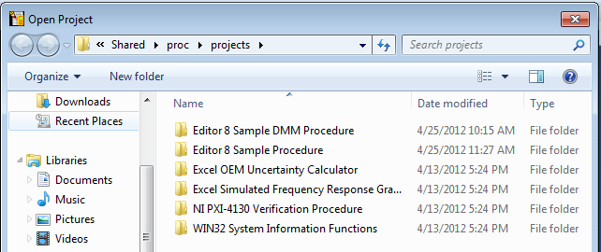
MET/CAL© Editor
Opening a Procedure to Edit…
Remember, there are 3 options to open:
Project /Solution
File…
Procedure…
Opening a Project (or Solution)
Notes:
Notice the directory it opens in

Slide 71
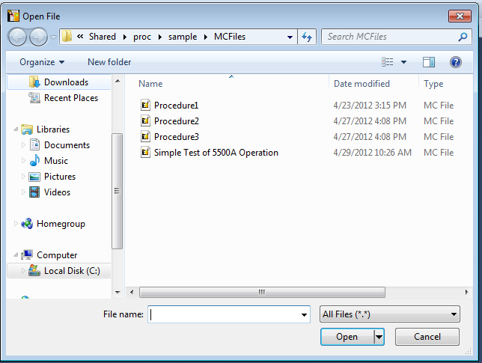
MET/CAL© Editor
Opening a File…
Notes:
Notice the file types at the bottom and the directory

Slide 72
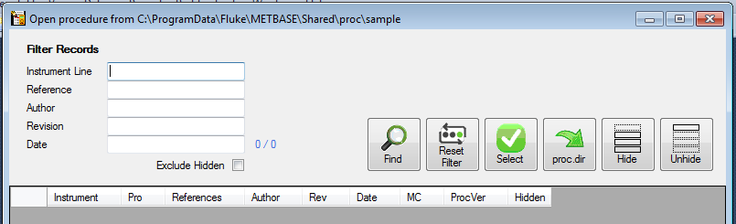
MET/CAL© Editor
Opening a Compiled Procedure…
Notes:
Notice the procedure selector opens, not a windows file open window…
Use this time to demonstrate how to use the filter options to pick out specific procedures

Slide 73
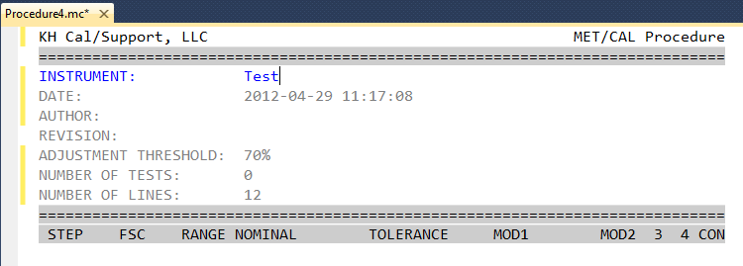
MET/CAL© Editor
Procedure Header Description

Slide 74
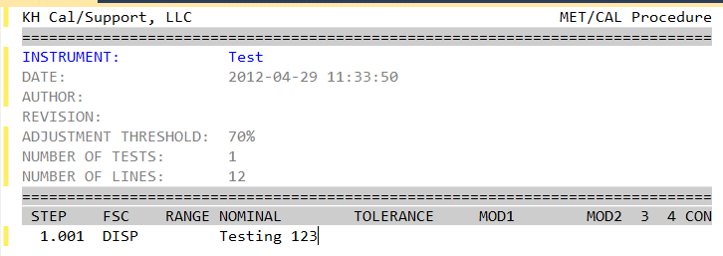
MET/CAL© Editor
Below the header, type:
  DISP TESTING 123
  Select F9
  Your Editor window should look like this:

Slide 75
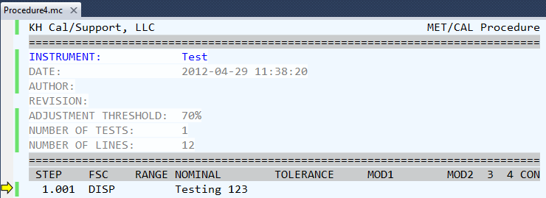
MET/CAL© Editor
Test Run the Procedure…
Start Debugging (F5) - F5 will start the debugger at the beginning of the procedure.
Debug from Cursor - Starts the debugger at the current cursor location.
Run (Ctrl-F5)- Once the debugger has started, press F9 to run the procedure
Note the Yellow arrow to the left of line 1.001

Slide 76
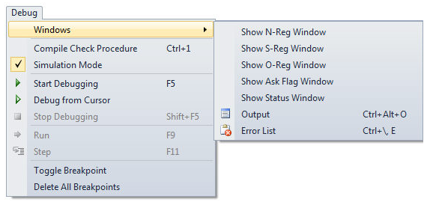
MET/CAL© Editor
Viewing the MET/CAL Memory Registers

Slide 77
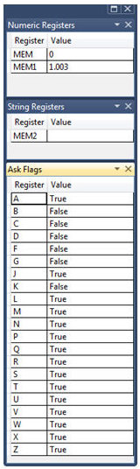
MET/CAL© Editor
The MET/CAL memory registers show the inner workings of MET/CAL while the procedure is running.
The windows can be shown individually or stacked as a group. (Shown stacked)

Slide 78
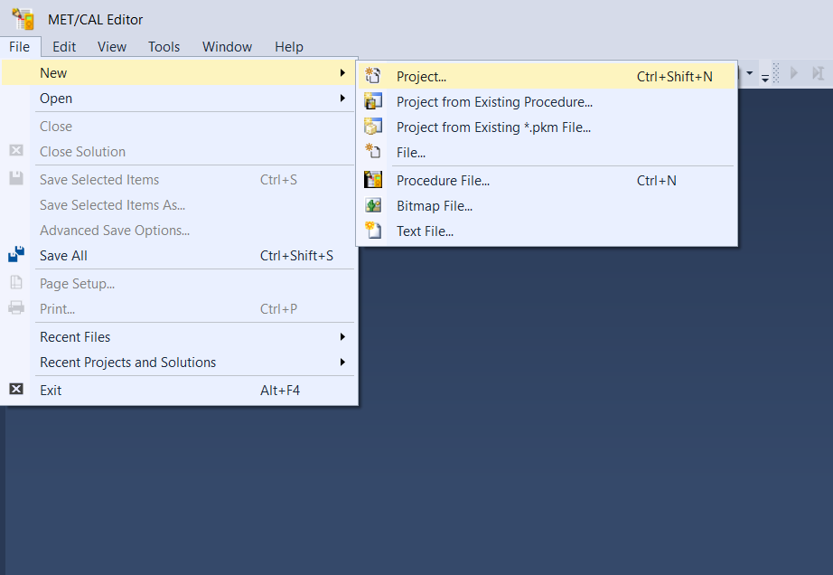
Work with Project and copy it to NEW
MET/CAL Editor has many ways to copy and create new procedure.
From beginning.

Slide 79
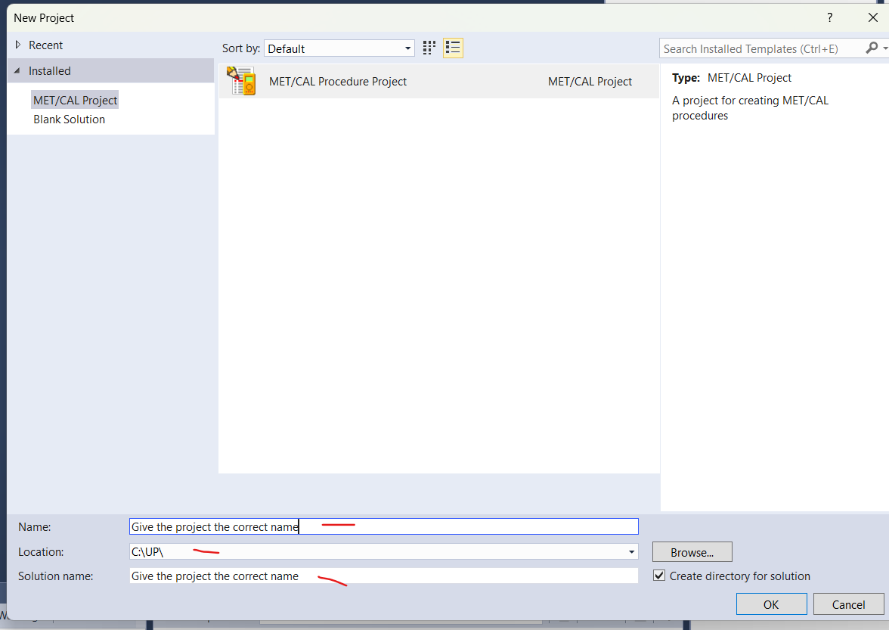
Work with Project and copy it to NEW
MET/CAL Editor has many ways to copy and create new procedure.
From beginning.

Slide 80
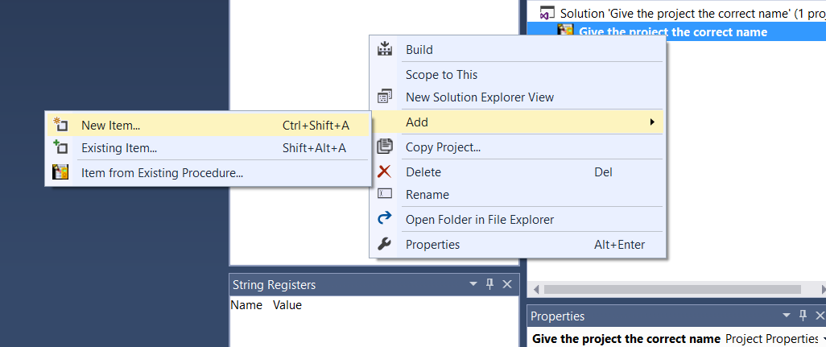
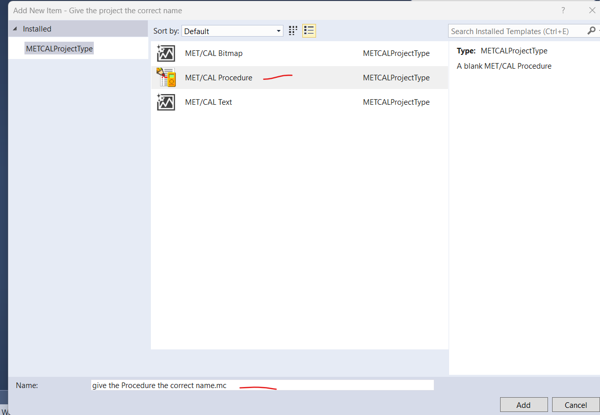
Work with Project and copy it to NEW
MET/CAL Editor has many ways to copy and create new procedure.

Slide 81
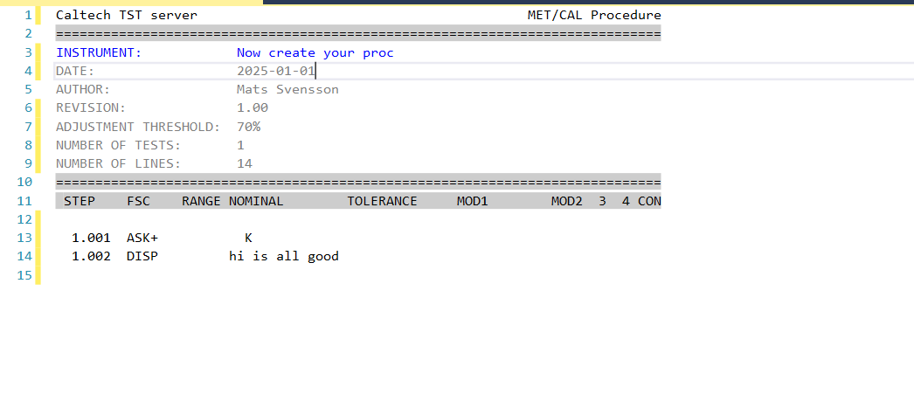
Work with Project and copy it to NEW
Now you can create your Procedure what is another part of the training

Slide 82
Work with Project and copy it to NEW
Add 6 sub proc named:
Sub1 Gen
Sub2 Gen
Sub3 Gen
Sub1 set
Sub2 set
Sub3 set
Compile the project.

Slide 83
Work with Project and copy it to NEW
LOOK IN TO THE FOLDER

Slide 84
Work with Project and copy it to NEW
LOOK IN TO THE FOLDER

Slide 85
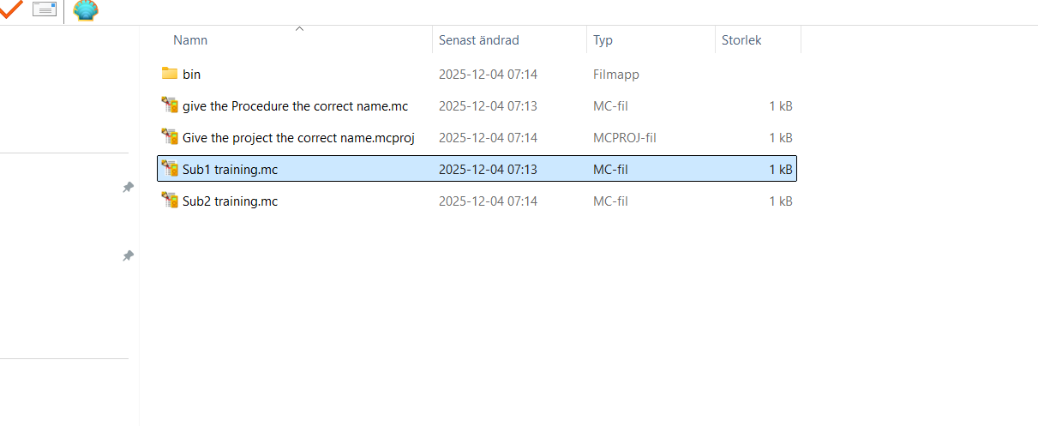
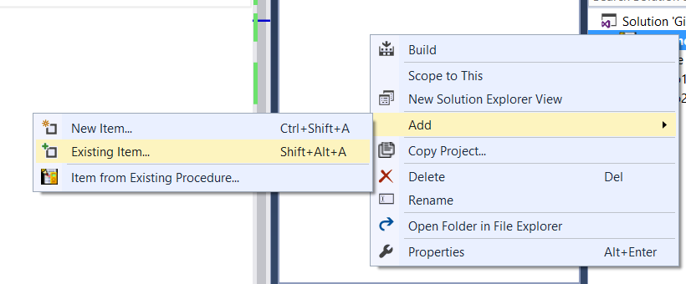
Copy all Data to a new proc. 1
Repeat the step before
Create a project from step 1
Create a proc from the step before
Go to Windows Explorer and copy the sub procedure
Past it in to the New project
Add it in MET/CAL under Existing Item

Slide 86
Copy all Data to a new proc. 1
If you also like to copy the Main proc you need to Rename it and set it as MAIN PROCEDURE
You can rename it before you add it into the project or in MET/CAL
Also rename the Instrument text in the Main proc and rename the project “PXE” File

Slide 87
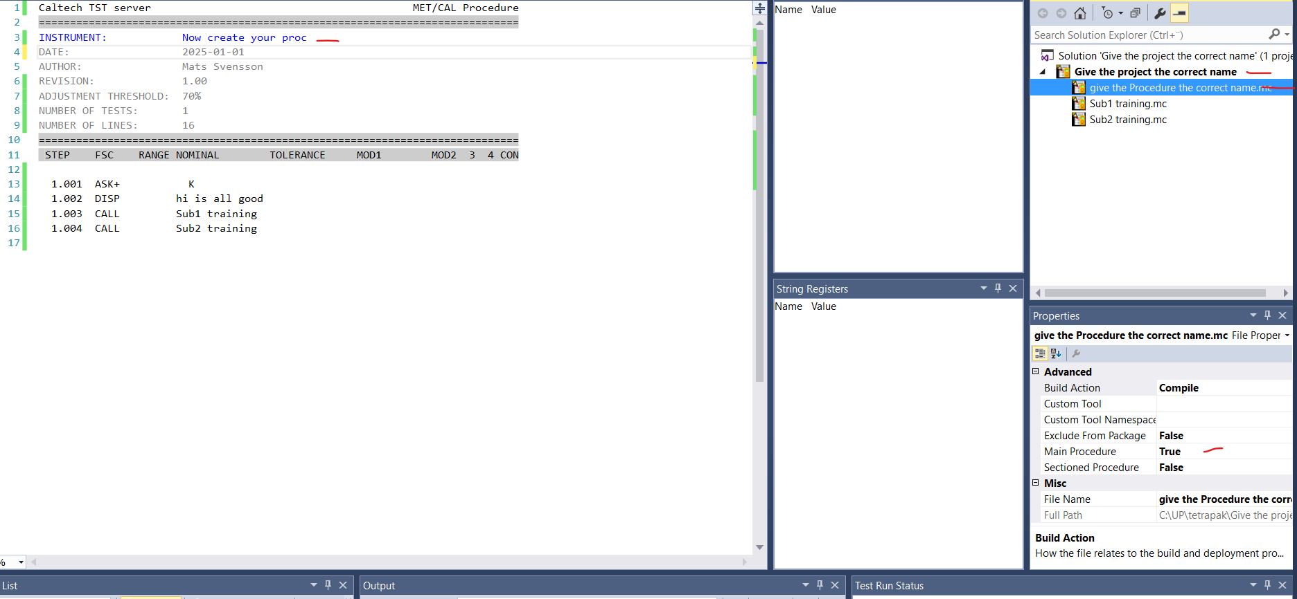
Copy all Data to a new proc. 1
If you also like to copy the Main proc you need to Rename it and set it as MAIN PROCEDURE
You can rename it before you add it into the project or in MET/CAL
Also rename the Instrument text in the Main proc and rename the project “PXE” File

Slide 88
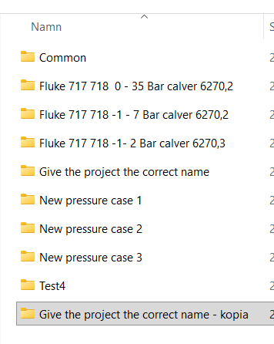
Copy all Data to a new proc. 2
Copy the complete project to a new catalog and rename it

Slide 89
Copy all Data to a new proc. 2
Copy the complete project to a new catalog and rename all

Slide 90
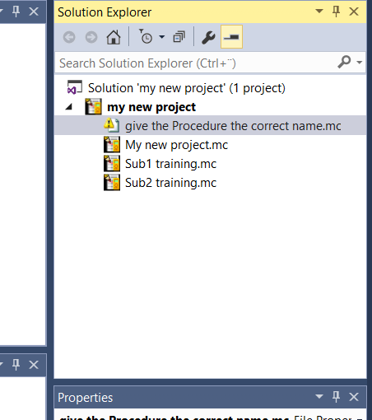
Copy all Data to a new proc. 2
Now you need to delete the old main proc and add the new one if you renamed it in explorer
Or
Rename it in MET/CAL what I prefer
Ranme the PXE

Slide 91
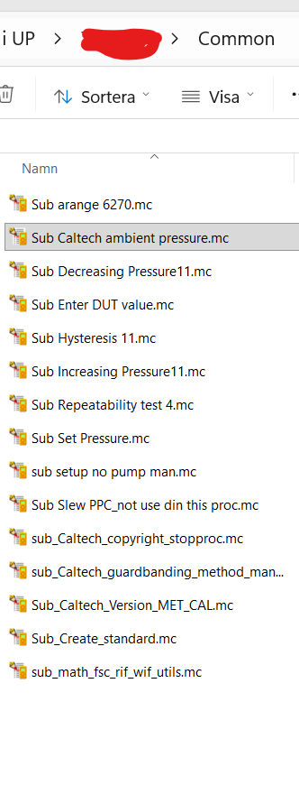
Copy all Data to a new proc. 3
Work with Command folders
Create 2 folders
Named Sub General1
Named Sub Set1
Rename the PXE

Slide 92
Copy all Data to a new proc. 3
Work with Command folders
Past all sub you have create to folder Sub General1
Rename the PXE

Slide 93
Copy all Data to a new proc. 3
Work with Command folders
Past only general subs to the catalog Sub General1
Past only “Set sub” to Sub1 Set1
Named Sub General1
Named Sub Set1
Rename the PXE

